Slide 1

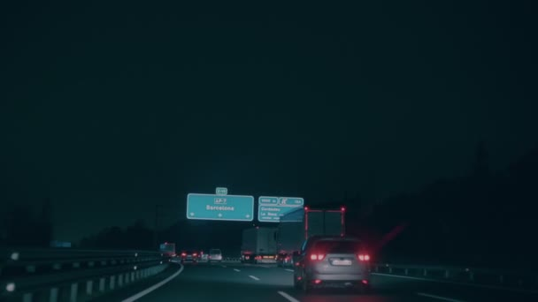
KOLHAPUR INSTITUTE OF TECHNOLOGY’S COLLEGE OF ENGINEERING KOLHAPUR
VEHICLE ACCIDENT PREVENTION SYSTEM
Presented by :
Vrishal Chandawarkar (B03)
Ritesh Dolare (B12)
Abhishek Gaikwad (B14)
Shubham Gaikwad (B15)
Name of Guide : Mrs. Ashwini Shinde

Slide 2
KOLHAPUR INSTITUTE OF TECHNOLOGY’S COLLEGE OF ENGINEERING KOLHAPUR
Contents
Problem Statement
Introduction
Component
Block Diagram
Circuit Diagram
Working
Result Advantages
Disadvantages
Application
Future Scope
Conclusion

Slide 3
KOLHAPUR INSTITUTE OF TECHNOLOGY’S COLLEGE OF ENGINEERING KOLHAPUR
PROBLEM STATEMENT
Road accidents are a serious problem that affects people worldwide. Some major reasons for road accidents are drowsiness and alcohol consumption while driving. Road accidents are one of the major public security issues that results in significant loss of life, property damage, and economic costs. To address this problem, there is a need for reliable and effective accident prevention systems that can detect signs of driver fatigue and impairment and take appropriate action to prevent accidents.

Slide 4
KOLHAPUR INSTITUTE OF TECHNOLOGY’S COLLEGE OF ENGINEERING KOLHAPUR
INTRODUCTION
Road accidents are a serious problem that affects people worldwide. Some major reasons for road accidents are drowsiness and alcohol consumption while driving. To address this problem, there is a need for reliable and effective accident prevention systems that can detect signs of driver fatigue and impairment and take appropriate action to prevent accidents. By taking this into consideration we have designed a “Vehicle Accident Prevention System” for drunk and drowsy drivers. In this system, whenever the driver will lose his concentration due to intoxication or drowsiness, an alarm will ring to wake him up. And, the driver does not wake up, even after the alarm, the vehicle will work in auto-driving mode and drive along the left side of the road and will be parked.

Slide 5
KOLHAPUR INSTITUTE OF TECHNOLOGY’S COLLEGE OF ENGINEERING KOLHAPUR
BLOCK DIAGRAM

Slide 6
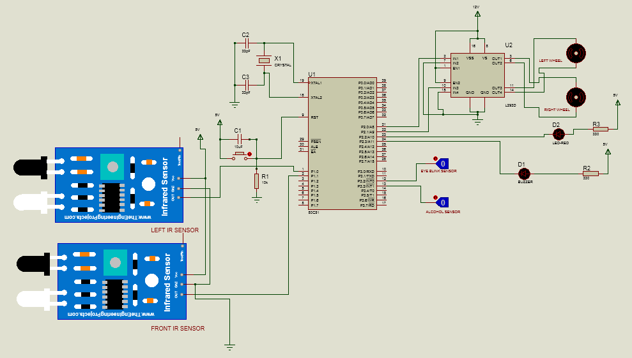
KOLHAPUR INSTITUTE OF TECHNOLOGY’S COLLEGE OF ENGINEERING KOLHAPUR
CIRCUIT DIAGRAM

Slide 7
KOLHAPUR INSTITUTE OF TECHNOLOGY’S COLLEGE OF ENGINEERING KOLHAPUR
Working
Our project aims to prevent accidents caused by drunk driving and drowsiness while driving. The project uses sensors to measure drowsiness and alcohol levels in a driver. The drowsiness sensor consists of an IR transmitter and receiver. By default, the sensor has a very high output without receiving any signal. The IR transmitter sends infrared rays to the driver's eye, and the IR receiver detects the reflected rays to determine whether the driver's eye is open or closed. If the eye is closed, the output of the IR receiver is high, otherwise it is low. This allows us to detect when the driver's eyes are closing or opening. The alcohol detector measures the content of alcohol in the driver's breath and attempts to prevent drunk driving. The system uses a microcontroller, an alcohol detector, and a buzzer. Interrupts of the microcontroller, such as INTO for eye blink and INT1 for alcohol sensor, are used.

Slide 8
KOLHAPUR INSTITUTE OF TECHNOLOGY’S COLLEGE OF ENGINEERING KOLHAPUR
The output of the alcohol sensor is directly proportional to the content of alcohol consumed, and this output is given to a logic circuit to indicate an alarm. When the driver's eyes are closed for three seconds, an alarm is triggered.
The output of the sensors is then fed to the microcontroller for comparison. The sensor outputs are analog in nature, and they need to be converted into digital format. This is done by the analog-to-digital converter of the microcontroller unit. Additionally, we are introducing two IR sensors to detect obstacles in front and to the left of the vehicle. If the driver is drunk or drowsy, the vehicle will go into an auto-drive mode and park on the left side of the road. We are also using a parking LED for indication purposes. This way, we can prevent accidents caused by unconscious driving due to drowsiness or alcohol consumption.

Slide 9
KOLHAPUR INSTITUTE OF TECHNOLOGY’S COLLEGE OF ENGINEERING KOLHAPUR
HARDWARE COMPONENTS
AT89S52 Microcontroller
Eye Blink sensor
MQ-3Alcoholsensor
IR sensors
Gear motors
Motor driver module
LED
Buzzer

Slide 10
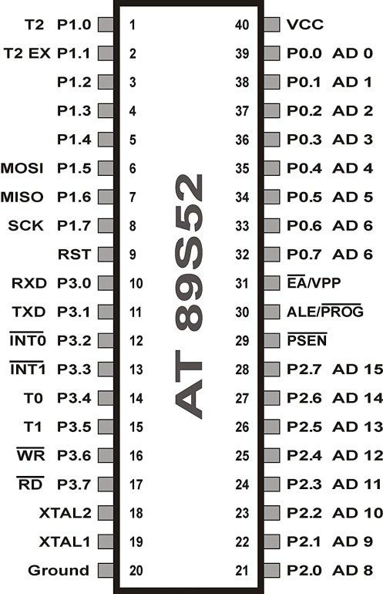
KOLHAPUR INSTITUTE OF TECHNOLOGY’S COLLEGE OF ENGINEERING KOLHAPUR
1. AT89S52 Microcontroller
Specifications:
8-bit microcontroller
5V Supply Voltage
40 pins, out of which 32 are used for Input and Output
4 kB ROM
128 bytes RAM
2 16-bit Timers or Counters
Serial Data transfer pins- TxD and RxD for transferring and receiving data serially
2 External Interrupt pins- INT0 and INT1
11.0596 MHz Crystal

Slide 11
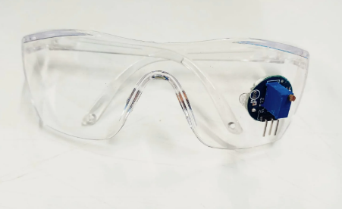
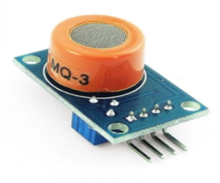
KOLHAPUR INSTITUTE OF TECHNOLOGY’S COLLEGE OF ENGINEERING KOLHAPUR
2. Eye Blink Sensor
Specifications:
Supply Voltage required : 5V
Output Volage : 5V
Eyes closed : Output- HIGH
Eyes open : Output- LOW
3. MQ-3 Alcohol Sensor
Specifications:
Supply Voltage required : 5V
Output Volage (Max) : 5V

Slide 12
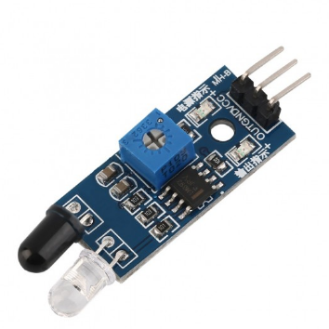
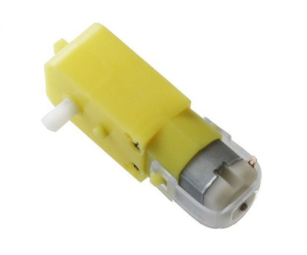
KOLHAPUR INSTITUTE OF TECHNOLOGY’S COLLEGE OF ENGINEERING KOLHAPUR
4. IR sensors
Specifications:
Supply Voltage: 5V
Wavelength range: 780nm to 1mm
Distance Range : 2cm to 20cm
Angular range : 0 to 35 degrees
5. Gear motors
Specifications:
Operating Voltage: 3V to 12V
Speed: 150 RPM
Torque: 0.35 kgcm

Slide 13
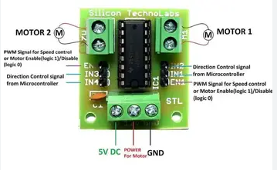
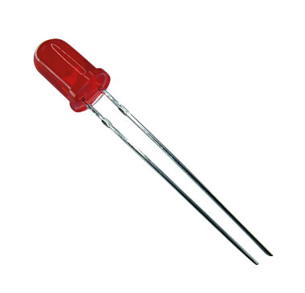
KOLHAPUR INSTITUTE OF TECHNOLOGY’S COLLEGE OF ENGINEERING KOLHAPUR
6. L293D Motor Driver
Specifications:
Supply Voltage Range : 4.5V to 36V
Input voltage(Min.) : 5V
Maximum current : 600mA
7. LED
Specifications:
Forward Voltage: 2.2V
Forward Current: 30mA
Wavelengths : 625nm

Slide 14
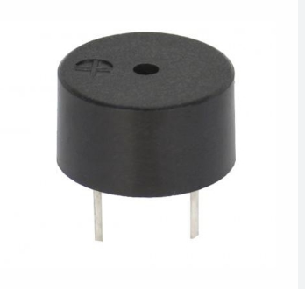
KOLHAPUR INSTITUTE OF TECHNOLOGY’S COLLEGE OF ENGINEERING KOLHAPUR
8. Buzzer
Specifications:
Supply Voltage : 5V
Sound frequency range : 1 to 7 kHz

Slide 15
KOLHAPUR INSTITUTE OF TECHNOLOGY’S COLLEGE OF ENGINEERING KOLHAPUR
RESULT
Front view of model
Top view of model

Slide 16
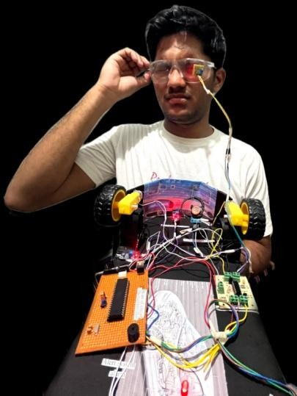
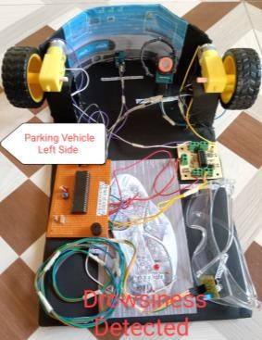
KOLHAPUR INSTITUTE OF TECHNOLOGY’S COLLEGE OF ENGINEERING KOLHAPUR
Testing Drowsiness Sensor
Drowsiness Testing
Drowsiness has been detected and vehicle has went into auto driving mode

Slide 17
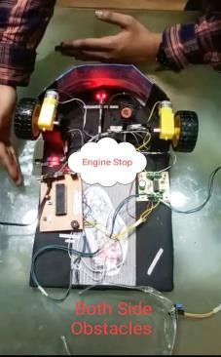
When obstacle is at left, vehicle moves forward
When obstacle is at front, vehicle moves left
When obstacles are at both directions, the engine stops

Slide 18
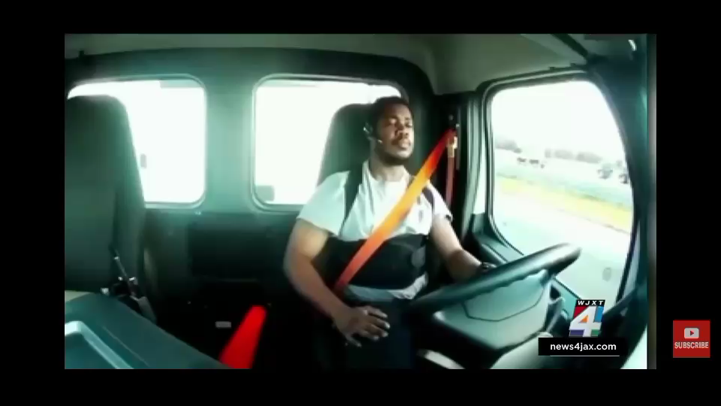

Slide 19
KOLHAPUR INSTITUTE OF TECHNOLOGY’S COLLEGE OF ENGINEERING KOLHAPUR
ADVANTAGES
The risk of road accidents is reduced
Parks the vehicle automatically
The system is very much dependable
Useful in mega-cities where people are constantly subjected to late-night driving
DISADVANTAGES
There is a risk of fake alarms: If the driver unintentionally closes his eyes for a slightly longer time he will be considered as sleepy. If alcohol sensor senses any alcoholic item such as hand sanitizer, the driver will be considered as drunk.
It can lead to accidents if IR sensors are damaged or their connection gets loose.
As this is a dependable system, there is a possibility that the number of people who drink and drive may increase.

Slide 20
KOLHAPUR INSTITUTE OF TECHNOLOGY’S COLLEGE OF ENGINEERING KOLHAPUR
APPLICATIONS
Reducing fatalities and injuries
Providing peace of mind for drivers and passengers
Insurance Companies
Commercial Fleets
FUTURE SCOPE
Incorporating Artificial Intelligence
Personalization
Improved Sensors
Remote Monitoring

Slide 21
KOLHAPUR INSTITUTE OF TECHNOLOGY’S COLLEGE OF ENGINEERING KOLHAPUR
CONCLUSION
The Accident Prevention system developed using an Eye Blinking Sensor and Alcohol Detector has been successfully implemented. This device is capable of detecting alcohol levels and drowsiness in drivers , and can be easily installed in vehicles, making it a highly useful safety feature. It has the potential to significantly reduce the number of accidents caused by drunk or drowsy drivers by auto-driving the vehicle to some extent and park the vehicle to left side of the road.
By using a microcontroller, the system has been programmed to include both an alcohol sensor and an eye blinking sensor, providing a comprehensive safety solution.In essence, this project is a significant step towards enhancing road safety and improving the overall safety of public spaces. Its success highlights the importance of using advanced technology to mitigate the risk of accidents caused by impaired drivers, and it has the potential to save numerous lives in the process.

Slide 22


